Slide 1
Beliefs About Intelligence
Complete the questionnaire.

Slide 2
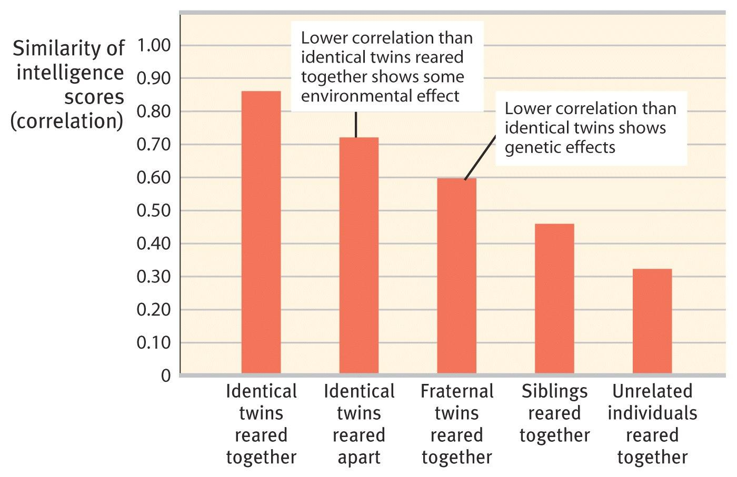
Nature & Nurture of IQ
Notes:
Remember: heritability is extent to which differences between individuals in the measurement group are linked to genetic variation

Slide 3
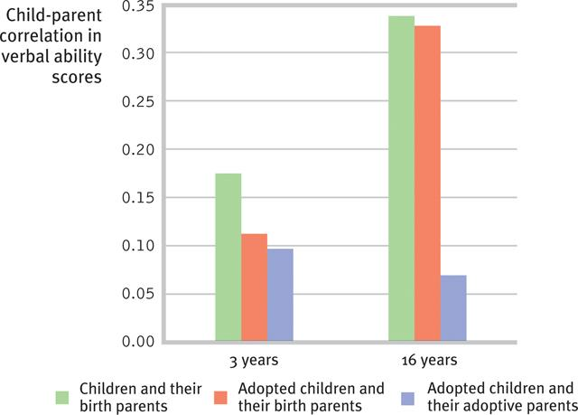
Nature & Nurture of IQ
Correlations between adoptive children and their biological parents actually INCREASE with time!

Slide 4
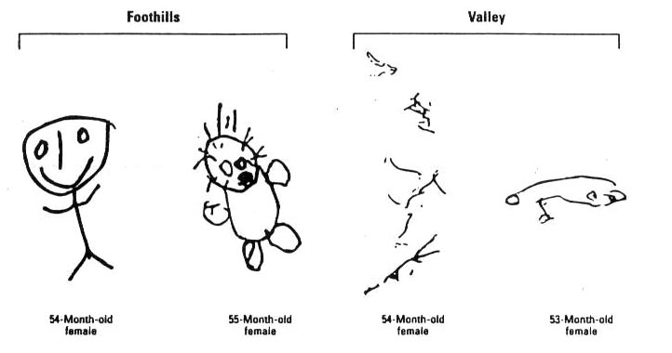
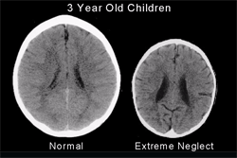
Nurture Matters
Early social deprivation, poverty, and malnutrition can all suppress IQ.
Schooling impacts IQ scores!
Perry, B. D., & Pollard, D. (1997). Altered brain development following global neglect in early childhood. Society For Neuroscience: Proceedings from Annual Meeting,New Orleans, 1997.
Guillette, E. A., Meza, M. M., Aquilar, M. G., Soto, A. D., & Garcia, I. E. (1998). An anthropological approach to the evaluation of preschool children exposed to pesticides in Mexico. Environmental Health Perspectives, 106(6), 347–353.

Slide 5
Our Beliefs About Intelligence Matter
Carol Dweck & “Mindset” Research

Slide 6

Carol Dweck: Growth Mindset

Slide 7
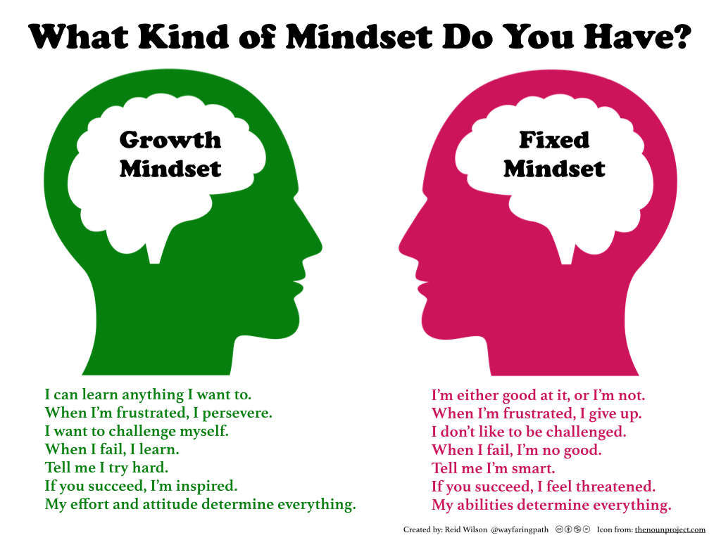
Notes:
Processing questions: Why is failure so much more intolerable with a fixed mindset?

